Slide 1

Identifying KOLs for Bright Life's NeuroShield
Notes:
Hello, and welcome to our presentation on “Identifying KOLs for Bright Life’s latest launch: Neuroshield”.

Slide 2


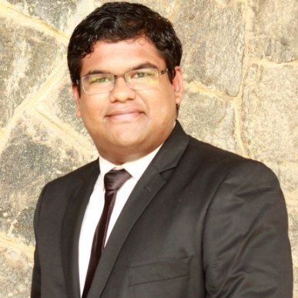




TEAM
Abhishek Krovvidi
Harshraj Jadeja
Shivam Mishra
krovvidi@purdue.edu
hjadeja@purdue.edu
mishr211@purdue.edu
linkedin.com/in/abhishek-krovvidi/
linkedin.com/in/harshraj-jadeja/
linkedin.com/in/shivam-mishra-b485b4142/
Notes:
I, Abhishek, am proud to share this presentation along with my team mates Harsh and Shivam.

Slide 3

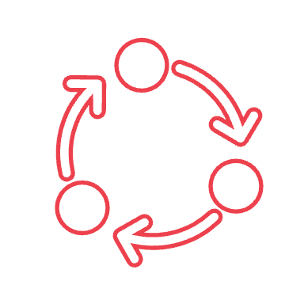


01
About the Product
NeuroShield: Cutting-Edge Protection for Brain Health, leveraging advanced neuroscience to shield against degenerative diseases and enhance cognitive function
02
Methodology
Encompasses data collection, preprocessing and EDA, culminating in the development of a scoring model for KOL selection
AGENDA
03
Data
Crafted by web-scraping with API’s, focusing on influential and customer-centric attributes for KOLs
04
Exploratory Data Analysis
Conducted to identify trends, patterns, and correlations in data for feature selection and optimization
Notes:
Let me take you through the agenda of the presentation. We start with the project scope, an introduction of the problem our latest product is trying to address, why it matters, it’s end customer profiles, and it’s target audience in the medical community.

Slide 4

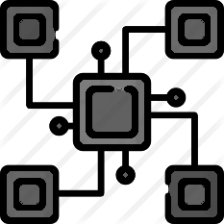
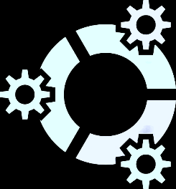

05
Data Preprocessing
Involves cleansing, structuring and refining the dataset to enhance the quality and reliability of the data
06
Model Building
Entails constructing a robust, scoring model and a network model to depict KOL influence
AGENDA
07
Final Recommendation
Implemented and managed the model through a dashboard, ensuring ongoing accuracy and adaptability to market changes
08
Future Scope
Address current limitations and expand the model's capabilities for broader, future applications
Notes:
We then take you through our journey of identifying the top two Key Opinion Leaders who can help make this product a success.

Slide 5




01
Project Scope
Defining project outline
Business Problem
Identify influential Key Opinion Leaders (KOLs) in the US Neurology market to support Bright Life company's new product launch strategy.
Project Outcome
A strategic plan identifying and engaging top KOLs in Neurology, enhancing product endorsement and adoption within the medical community.
Analytics Problem
Develop a methodology to analyze datasets, including clinical trials, research publications, leadership roles, and financial engagements, to identify and rank KOLs.
Key Deliverables
A presentation detailing the analysis methodology, KOL profiles, and a comprehensive list of identified KOLs, supported by analysis files/codes.
Notes:
The project scope consists of the business problem, expected project outcome, converting the business problem into an analytical problem, and the key deliverable. The final deliverable is a profile slide on each of the two KOLs best suited for NeuroShield.

Slide 6
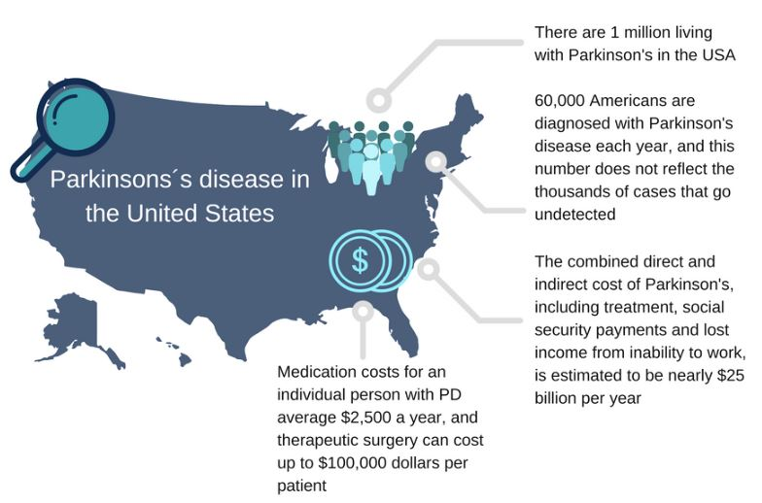
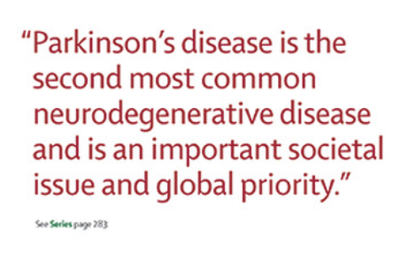
01
Why?
Introducing the Product
Notes:
Parkinson’s disease has been one of the active areas of research for our client Bright Life. More than 60,000 Americans and 200,000 worldwide are diagnosed with Parkinson’s disease every year. A individual with Parkinson’s disease spends about $2,500 every year on medication alone, leave aside the costs on treatment and income lost from inability to work.
Early intervention is a proven way to reduce these impacts of the disease on an individual’s life.

Slide 7





01
About the Product
Introducing the Product
NeuroShield: Early Parkinson's Intervention Therapy
Real-time Monitoring and Insights Generation
Early Detection Algorithm
Localized TMS Therapy
Wearable and Non-Invasive
Notes:
That’s why our client introduced “Neuroshield”.
Neuroshield is a wearable, non-invasive device that helps detect early symptoms of Parkinson’s disease through TMS, offers real-time monitoring and data insights. Through it’s companion app, it also offers a plethora of knowledge on the disease and also therapy options.

Slide 8
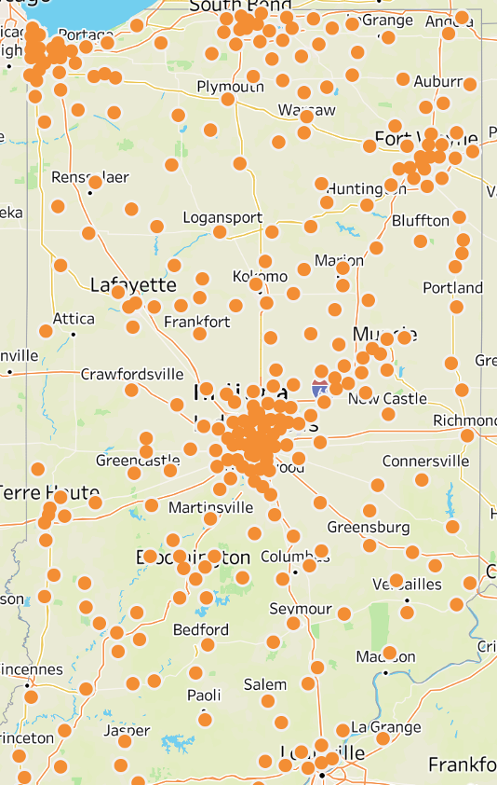
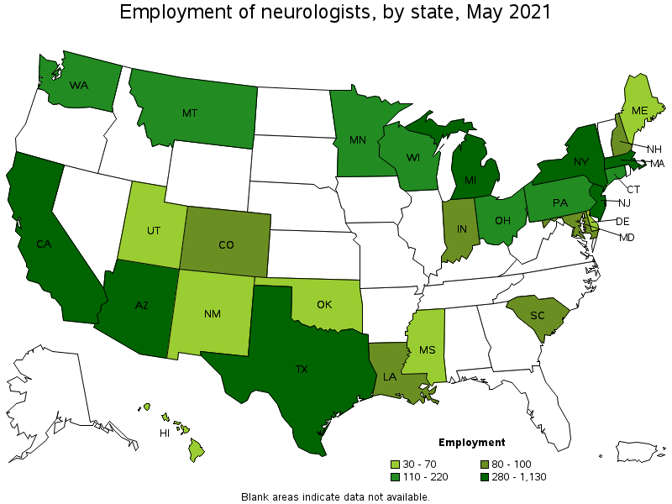
01
Target Audience
Introducing the Product
Notes:
Bright Life would like to promote this product to all neurology practitioners across the United States through various marketing strategies, including expert opinions of the KOLs.

Slide 9




02
Methodology
Analytical process framework
Identify Datasets
Explore the given datasets and beyond to find the required datapoints
Shortlist the required attributes
Categorize attributes, such as publications, citations, and affiliations
Web Scraping
Collect the required data using Python Libraries, APIs, and downloadable Excel files
Exploratory Data Analysis
Identify trends and patterns in data
Data Frame Creation
Join the gathered tables to create a master dataframe

Slide 10
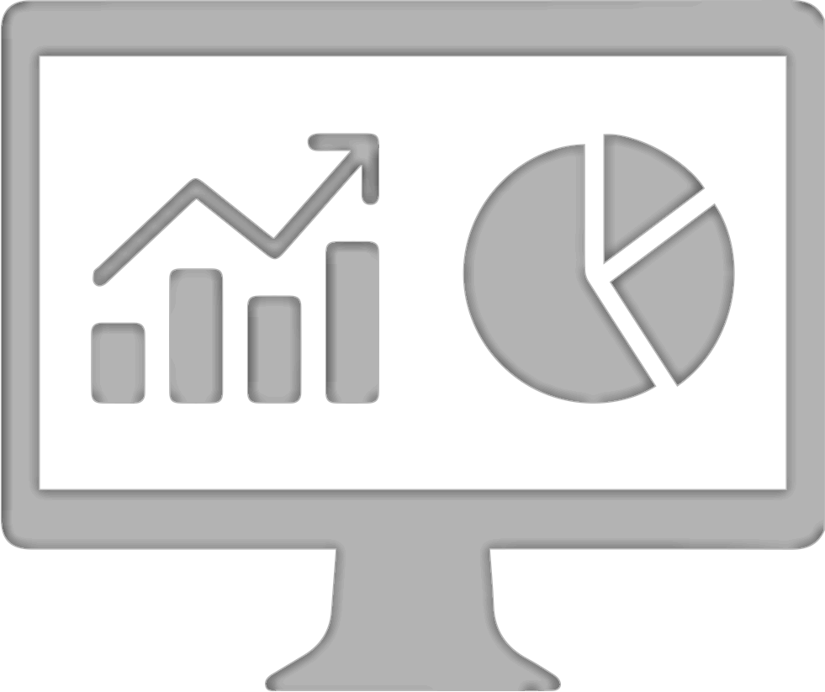

Data Preprocessing
Filter data by removing / imputing the records to get a cleaner dataset
Feature Engineering
Altering the required features as it suits best to create a model
Modeling
Rank all the profiles based on a scoring metric and select top 10 profiles
Future Scope
Explore how to scale this model to different fields of medicine
Recommendations
Shortlist the accumulated profiles further based on social reach and accomplishments to get the top 2 profiles
Notes:
Moving forward, we perform extensive data preprocesing and feature engineering before entering our modelling phase. Our modelling phase involves us scoring a KOL in the scale of 0 to 100, 100 being the best score

Slide 11






03
Datasets
Collection of clinical trials data and payments data for a physician
Knowledge/Prior Experience
Social Influence
Research Journals
Clinical Trials
Twitter/LinkedIn
Pub Med
Clinical Trials . Gov
No of followers
Research Payments
Affiliations
US News Ratings
Open Payments Data
Web of Science
Sentiments

Slide 12
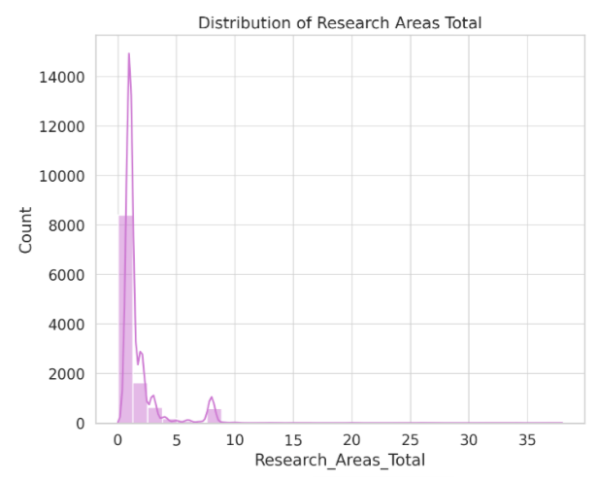
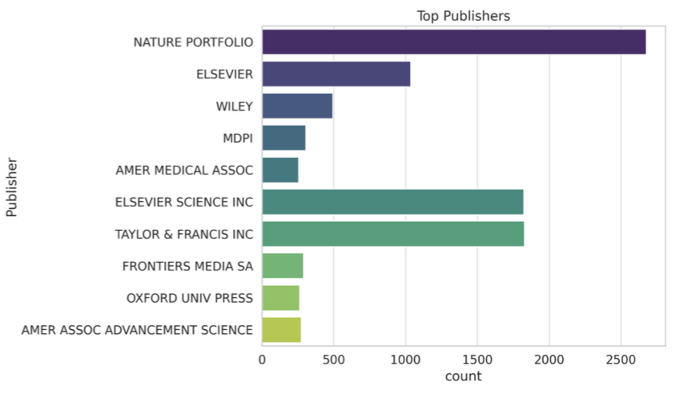
04
Exploratory Data Analysis
To identify trends, patterns, and correlations in data for feature selection and optimization
Visualizes the total number of research areas covered by the authors, indicating that most authors focus on a limited number of research areas, with a few exploring a broader range
Provides a count of publications by the top publishers in the dataset, illustrating which publishers are most prevalent among your dataset's publications

Slide 13
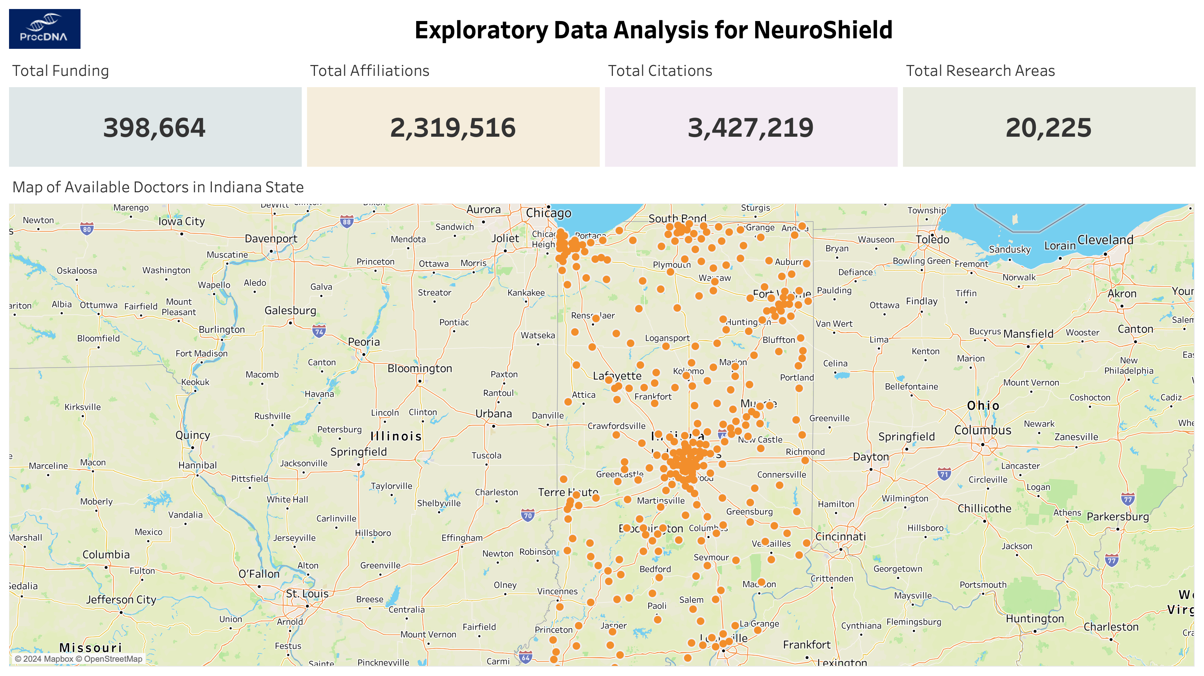
Notes:
For our Exploratory Data Analysis, we looked at 4 parameters – Funding, University / Organization Affiliations, Total Citations, and Total Research Areas of all the neurologists in the United States.
We also looked at the geographical distribution of neurological practitioners in the state of Indiana to get an idea of the distribution across urban, sub-urban, and rural areas of the state. The same can be replicated for all states in the US.

Slide 14

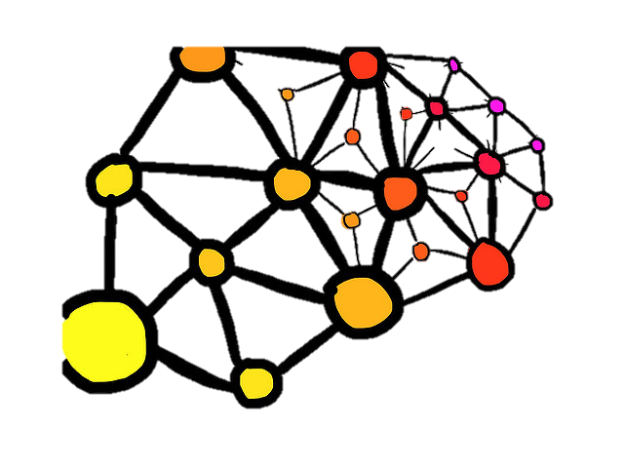


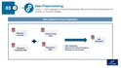
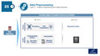
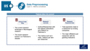
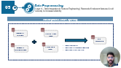
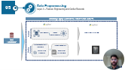
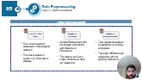
05
Data Preprocessing
Enhances the quality and reliability of the data, paving the way for more accurate and meaningful insights
Why?
Data Preprocessing Framework
Removing irrelevant and highly correlated columns improves the overall quality and reliability of the dataset
Enhance Data
Quality
By creating new features through effective bucketing and data manipulation, we ensured removing noise
Feature Engineering
Layered Approach
Removing nulls from columns helps in maintaining the integrity of the dataset, ensuring that the analysis is not skewed
Ensure Data
Integrity
Removing outliers can enhance model accuracy by reducing noise and ensuring the training process focuses on the more representative patterns of the data
Removal of
Outliers

Slide 15

05
Data Preprocessing
Layer 1 – Data Integration & Feature Engineering | Removal of irrelevant features & null records, to increase reliability
Data Integration & Feature Engineering
Research Journals
Clinical Trials Data
KOL Dataframe
Data Integration
Removal of irrelevant features
Removal of null records
Research Payments Data
Physician’s Data
Notes:
HJ

Slide 16






05
Data Preprocessing
Layer 2 – Feature Engineering and Outlier Records
Handling Highly Correlated Features and Outliers
Feature
Engineering
Bucketing
Data manipulation
Removal of noise!
KOL
Dataframe
Understanding
Outliers
Interpretation
Outlier
Detection
Box-Plots Creation
Removal of outliers
Notes:
HJ

Slide 17
05
Data Preprocessing
Layer 3 – Metrics considered
Features taken into account
Clinical Trials Data
Research Journals
Research Payments Data
The current research landscape in Neurological research
The recent research trends in on Parkinson’s disease
Authors/Researchers with the highest publications and citations on Parkinson’s
The metrics such as h index, citations per item per researcher
Total payments made to a researcher by funding companies
The major affiliations per researcher with the granting institutions
Notes:
HJ

Slide 18


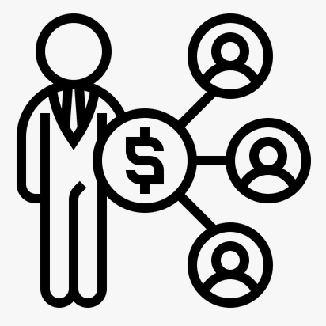

06
Model Building
Stage 1 | Heuristic Scoring Model
Citation
Funding
Affiliations
Research
40%
30%
20%
10%
Total citations per KOL highlight their significance and ongoing impact within the neurology field
Total funding and number of grants per KOL reflect the extensive financial support and trust from funding bodies
Total affiliations per KOL showcase their extensive network and esteemed positions in the medical and academic communities
The number of unique research areas per KOL demonstrates their broad interests and significant contributions to neurology

Slide 19
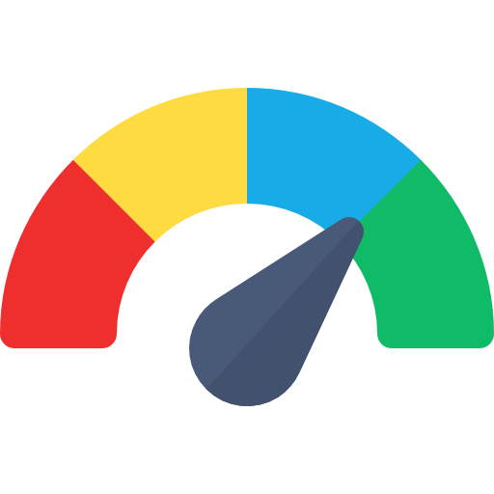




07
Final Recommendation
Leadership Positions
KOL Profiles
Heuristic Score Ranking
KOL Mapping Influence Network
Social Influence
Notes:
HJ

Slide 20
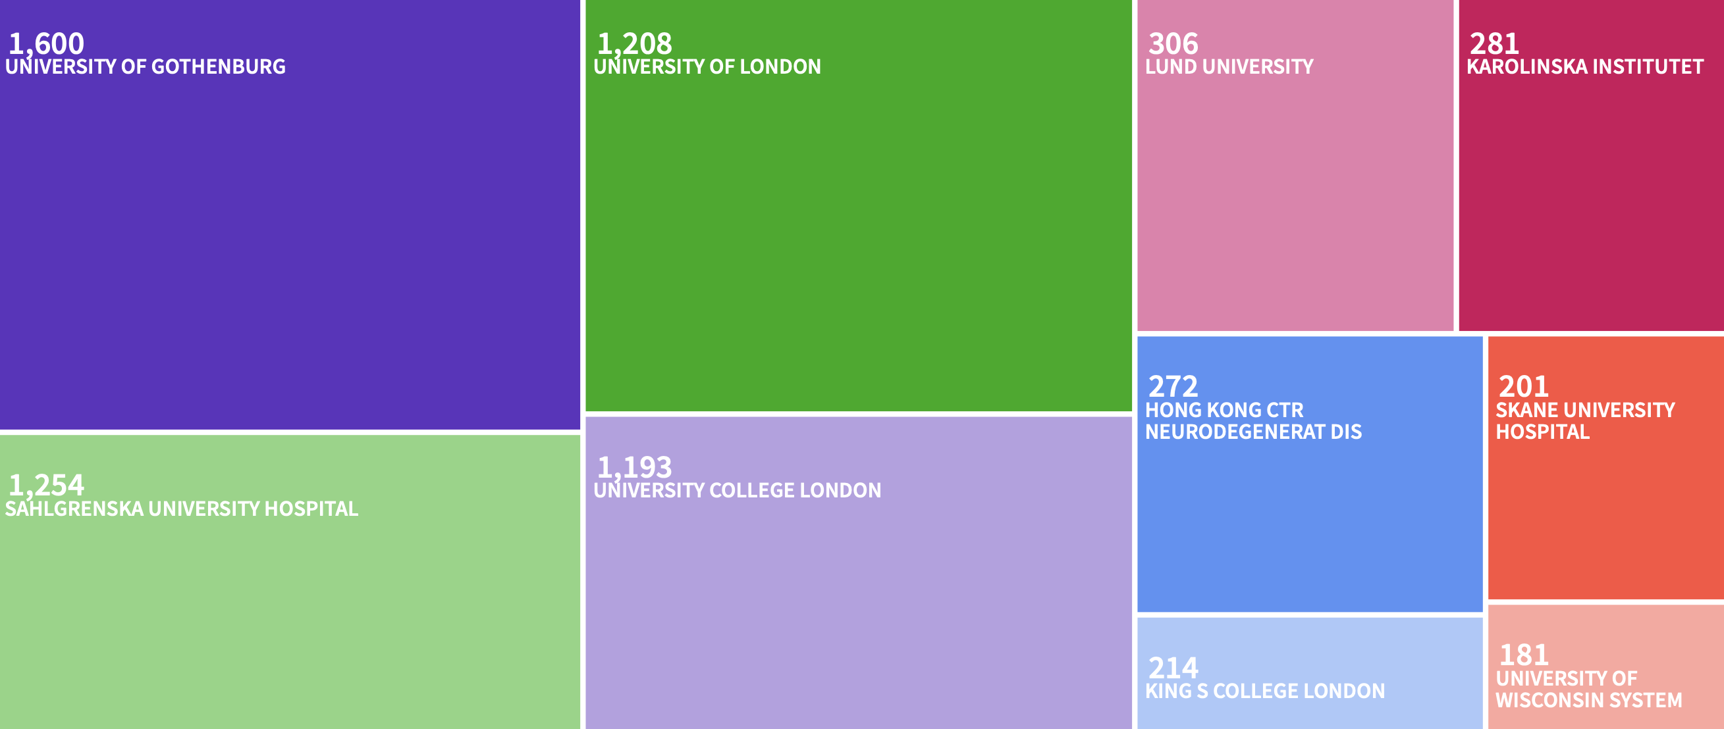








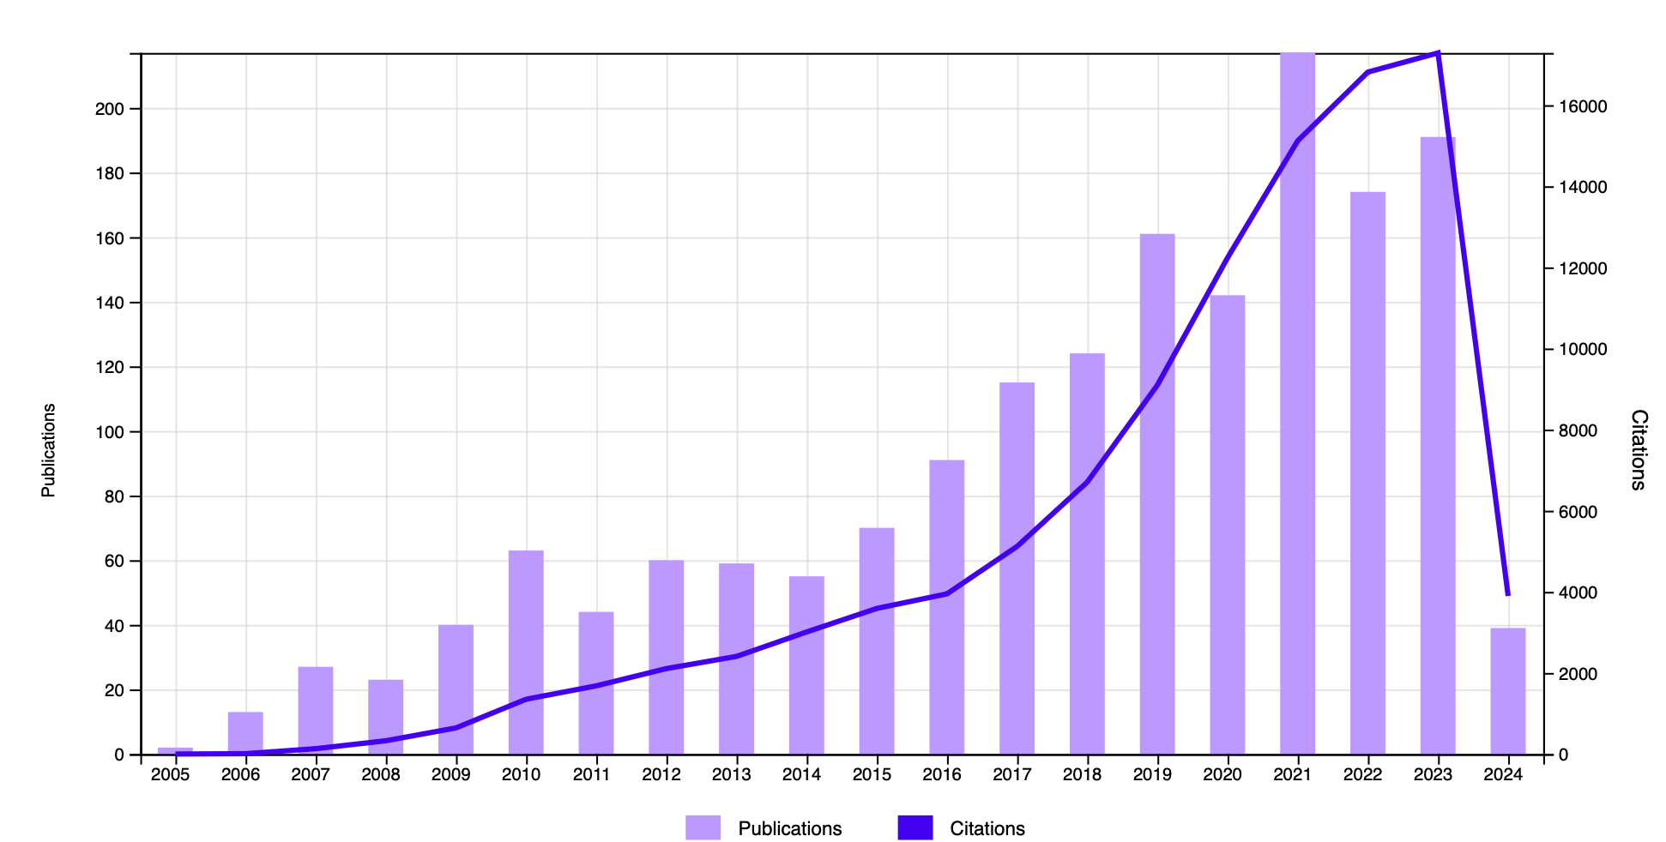



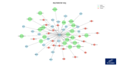
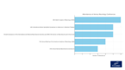
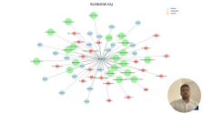
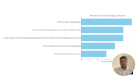
BLENNOW KAJ
Key Research Areas
Affiliations
Neurosciences Neurology
Psychiatry
Cell Biology
Geriatrics Gerontology
Leadership
Professor/Chief Physician | University of Gothenburg
kaj.blennow@clinchem.gu.se
Specialty: Clinical Neurology
Research Journals
77.3
1,710
Influence Score
Interests
Publications
105K
Good health & well-being
Citations
144
Gender Equality
H-Index
Zero Hunger

Slide 21


Slide 22
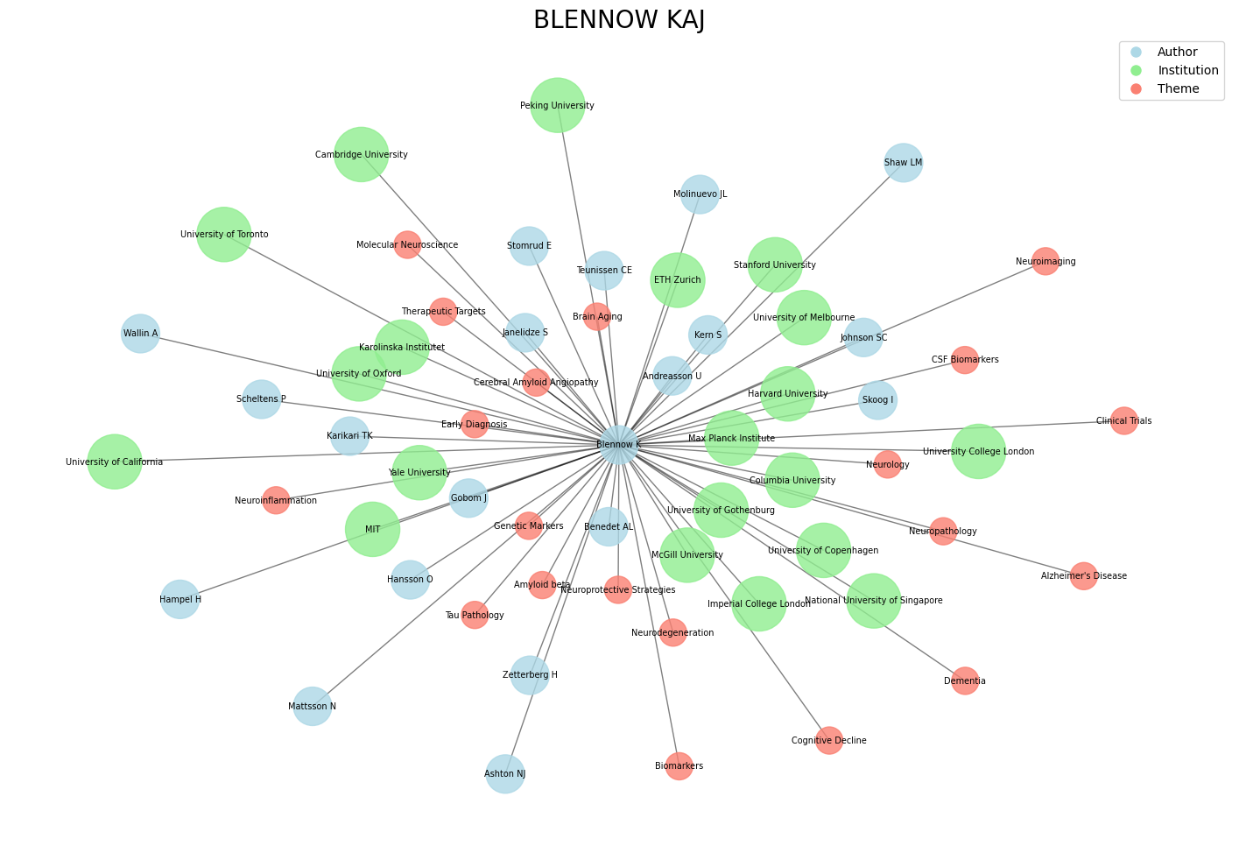

Slide 23
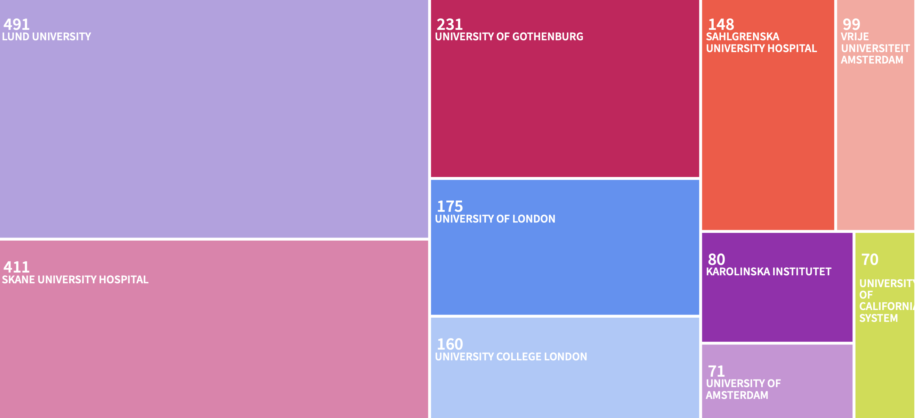

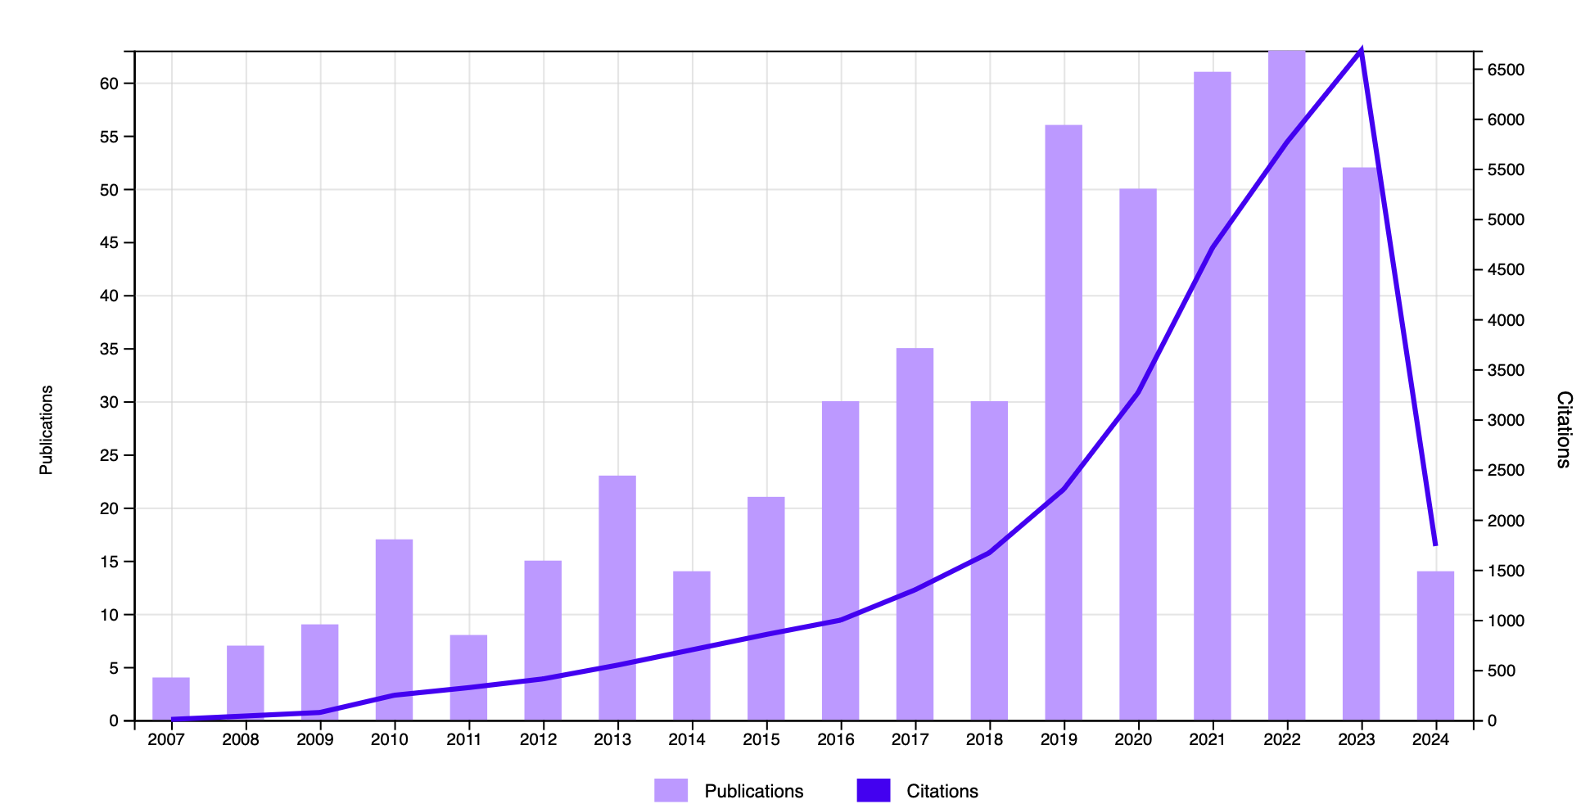
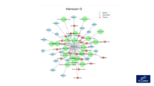
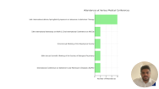
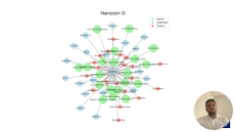
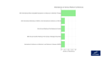
HANSSON OSKAR
Key Research Areas
Affiliations
Neurosciences Neurology
Radiology
Cell Biology
2.4k+
Science Technology
Leadership
Professor of Neurology| Lund University
https://twitter.com/OskarHansson9
Specialty: Neurology
Research Journals
100
509
Influence Score
Interests
Publications
31K
Good health & well-being
Citations
98
Gender Equality
H-Index

Slide 24
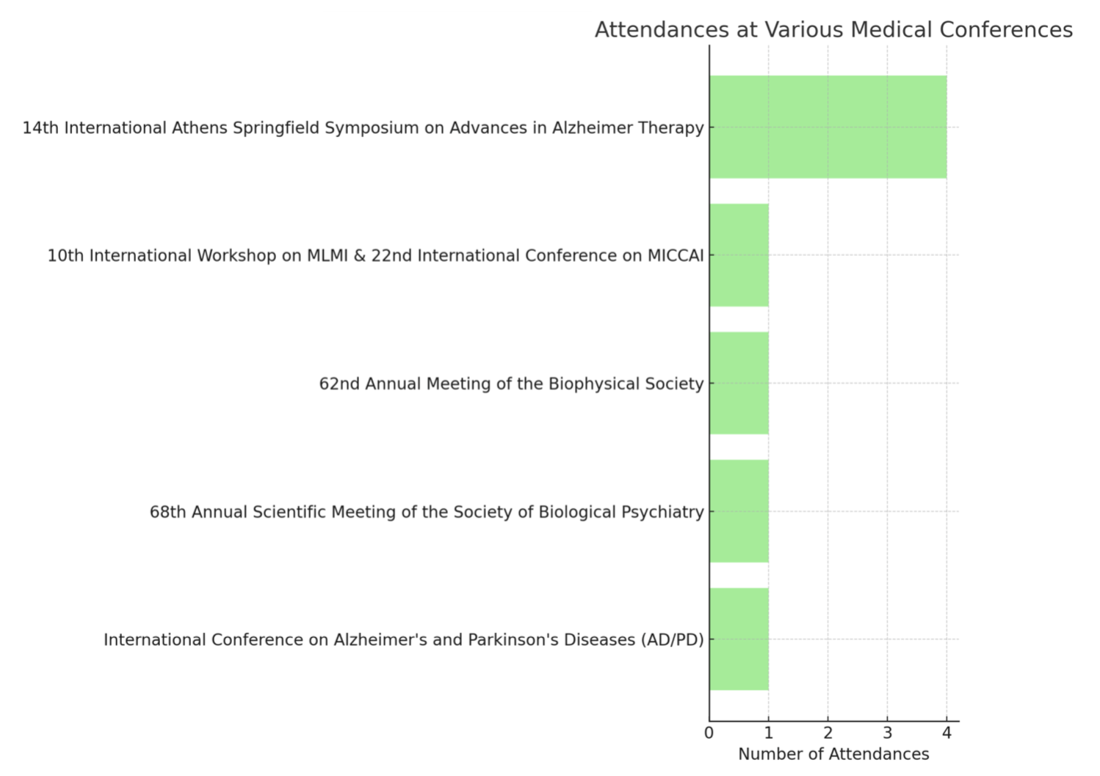

Slide 25
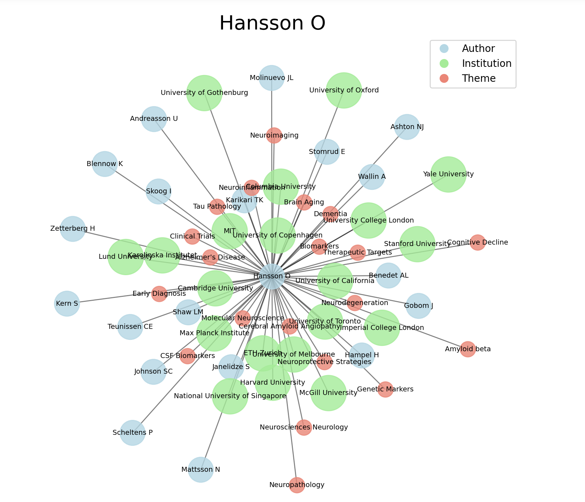

Slide 26




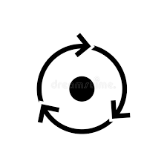

07
Validation/Accuracy Assessment
Timeliness
Data arrival at a specified time interval
Check for “late data” arrival
Uniqueness
Check duplication of records at specified level of data ( Primary key )
Accuracy & Validity
Trend based anomaly detection for specified fields – flag anomalies outside statistical tolerance bands
Categorical columns have a valid entry from a defined list of values
Have business sense checks in place
Consistency
Compare data between tables to ensure accurate numbers (use the aggregated view as benchmark)
Comparison with Business forecasts
Completeness
Null/missing value checks
Outlier detection for the volume of data arriving on a day – compare the count of rows within a window of the last 30 days and send an alert if it’s outside a defined limit
Timeliness, Uniqueness, Accuracy & Validity would be a part of general checks (that could be leveraged for all the datasets)
Consistency & Completeness checks must be tailored/customized as per the specific datasets

Slide 27



08
Future Scope
Address current limitations and expand the model's capabilities for broader, future applications
01
Data Source Enhancement
Incorporate premium datasets for deeper insights and superior KOL profiling accuracy, moving beyond freely available internet resources.
02
Scope Expansion to Other Medical Fields
Extend the KOL identification framework to additional medical specialties beyond neurology, broadening the study's applicability and impact
03
Leveraging Advanced Visualization and ML Models
Enhance visibility and insights for KOL identification with advanced visualization techniques and leverage historical data in ML models for improved precision in data-driven approaches
Notes:
HJ

Slide 28
Thank You

